Slide 1


Valkyrie: Vulnerability Assessment Tool & Attack for PSLL Techniques
Final Project Presentation
Presented by: Himanshu Kumar Under the Guidance of Professor: Dr. Satwik Patnaik Course: CPEG675 - IoT and Embedded Systems Security Semester/Year: Spring-2024 IEEE Paper reference Link:
Author: Dr. Satwik Patnaik & Dr. Nimisha Limaye
DOI={10.1109/TIFS.2022.3149147}
05/14/2024

Slide 2
Project progress bar graph representation
Project proposal 02/27, 2024
Presentation day: 05/14/2024
Acquire PI and KI involved in Dlock
02/27 - 03/17, 2024
SFLT (POP and CS1Finding)
03/17 - 03/21, 2024
DFLT (CS1 and CS2 finding)
03/21 - 03/28, 2024
Finding SFLT CSV value
03/28 – 04/09, 2024
Finding DFLT CSV value
04/10 – 04/12 2024
Testing patterns 04/12 – 05/10 2024
Report generate
Attacking PSLL techniques (without using oracle) 05/01 – 05/13 2024

Slide 3
Presentation flow:
- Problem Motivation, Problem statement, and relevance to IoT and embedded system security
- Tools used and useful function definitions in circuitgraph
- Implemented methodology:
i) Finding PI, KI and POP
ii) Finding CS1 and CS2 for SFLT & DFLT
iii) SFLT Circuit restoration: Inserting fault at CS1 to find CSV
iv) DFLT Circuit restoration: Inserting fault at CS1 & CS2 to find CSV
v) Circuit Recovery Attack overview
vi) CR attack process and finding CSV without using Oracle
- Test results & Demo
- Deliverables achieved and not achieved
- Summary

Slide 4
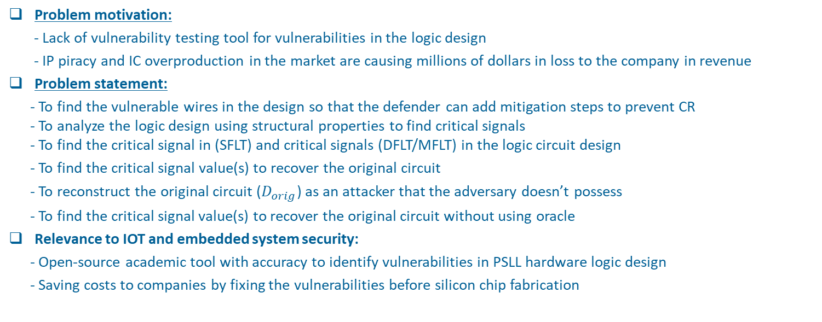
Statement | Tools & Function def. | Acquire PI, KI & POP | Find CS | SFLT CSV | DFLT CSV | CR attack | Test results & demo | Deliverable | Summary |
Problem motivation, statement and Relevance to IOT & embedded system security:
Problem motivation:
- Lack of vulnerability testing tool for vulnerabilities in the logic design
- IP piracy and IC overproduction in the market are causing millions of dollars in loss to the company in revenue
Problem statement:
- To find the vulnerable wires in the design so that the defender can add mitigation steps to prevent CR - To analyze the logic design using structural properties to find critical signals - To find the critical signal in (SFLT) and critical signals (DFLT/MFLT) in the logic circuit design
- To find the critical signal value(s) to recover the original circuit
- To reconstruct the original circuit ($D_{orig}$) as an attacker that the adversary doesn’t possess
- To find the critical signal value(s) to recover the original circuit without using oracle
Relevance to IOT and embedded system security:
- Open-source academic tool with accuracy to identify vulnerabilities in PSLL hardware logic design
- Saving costs to companies by fixing the vulnerabilities before silicon chip fabrication

Slide 5
Statement | Implemented method. | Acquire PI, KI & POP | Find CS | SFLT CSV | DFLT CSV | CR attack | Test results & demo | Deliverable | Summary |
Implemented methodology:
List of tools used in this project:
- abc, Atalanta, iverilog, circuitgraph
Resources defenders have: - Original/Oracle circuit design netlist - Locked circuit design netlist
Ideal resources attackers have:
- Locked circuit netlist
Useful function definitions in circuitgraph tool:
- endpoints: Returns a list of primary output(s) which lies in the fanout of signal net
- startpoints: Returns a list of primary input(s) which lies in the fanin of the signal net
- fanin: Returns a list of immediate fanin (neighbors) of the signal net
- transitive_fanin: Returns a list of all wires till startpoints which lie in the fanin of the signal net
- transitive_fanout: Returns a list of all wires till endpoints that lie in the fanout of signal net

Slide 6
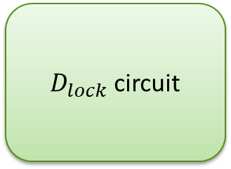

Statement | Implemented method. | Acquire PI, KI & POP | Find CS | SFLT CSV | DFLT CSV | CR attack | Test results & demo | Deliverable | Summary |
Find primary input (PI) and keyinput (KI):
- Look for the wires where primary input (PI) and keyinputs (KI) are the inputs.
a
$D_{orig}$ circuit
b
c
POP = Y
a
$D_{lock}$ circuit
kf0
b
kf1
a
kg0
PI: {a, b} = 2 KI: {kf0, kf1, kg0, kg1} = 2^(2) = 4 PI + KI = 6
b
kg1
Fig. 1: Simplified Locked circuit representation

Slide 7

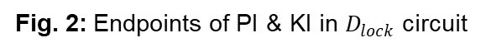
Statement | Implemented method. | Acquire PI, KI & POP | Find CS | SFLT CSV | DFLT CSV | CR attack | Test results & demo | Deliverable | Summary |
Find POP (Protected Output Port):
- POP should be derived from the inputs in the $D_{lock}$ part of the circuit.
a
$D_{orig}$ circuit
b
c
POP = y
a
$D_{lock}$ circuit
kf0
b
kf1
a
kg0
PI: {a, b} = 2 KI: {kf0, kf1, kg0, kg1} = 2^(2) = 4 PI + KI = 6 POP: y
b
kg1
Fig. 2: Endpoints of PI & KI in $D_{lock}$ circuit

Slide 8
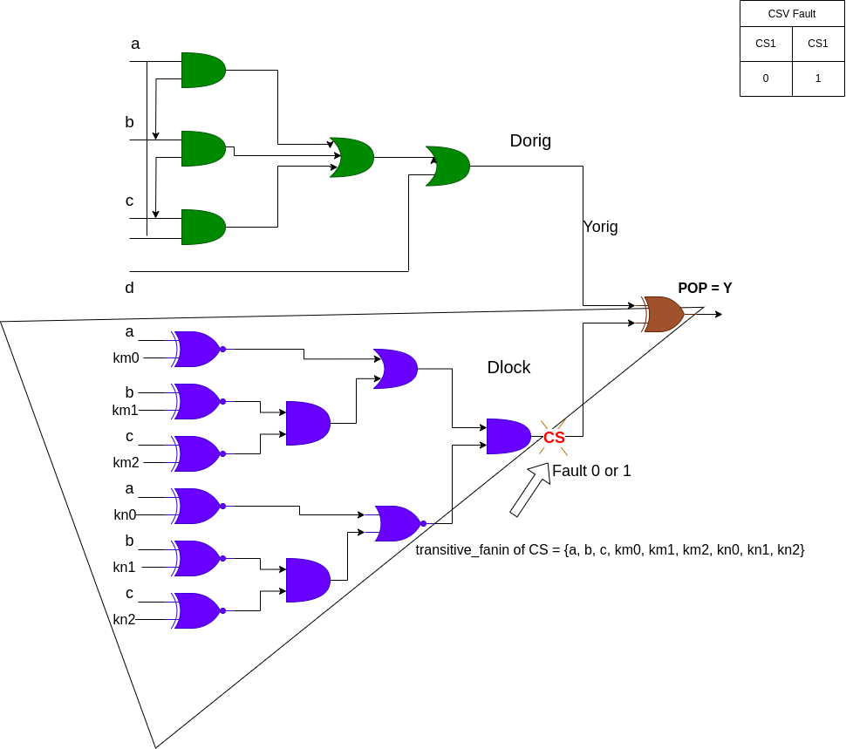
Statement | Implemented method. | Acquire PI, KI & POP | Find CS | SFLT CSV | DFLT CSV | CR attack | Test results & demo | Deliverable | Summary |
Finding CS1 and CS2 for SFLT & DFLT:
net --> Loop through each net in the POP_fanin list
For net in POP_fanin:
- find startpoints of the net (pi_net) - find transitive fanout of net (pi_net_transitive)
- find endpoints of the net (co_net)
Check If the below condition matches: - Condition to find CCS1: if co_net == pop and (set(pi_net) == set(mapped_set)) CCS1_set.add(net) - Condition to find CCS2:
if set(pi_net) == set([item for item in mapped_set if item in
PI]) and co_net == pop
Fig. 3: Inserting fault at CS1 to restore the original circuit

Slide 9
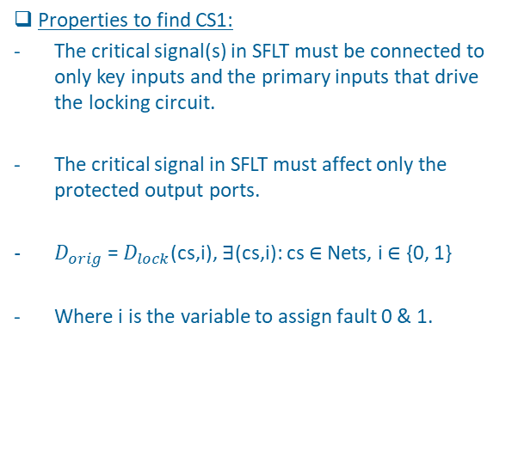
Statement | Implemented method. | Acquire PI, KI & POP | Find CS | SFLT CSV | DFLT CSV | CR attack | Test results & demo | Deliverable | Summary |
Critical signal values on SFLT designs:
Properties to find CS1:
The critical signal(s) in SFLT must be connected to only key inputs and the primary inputs that drive the locking circuit.
The critical signal in SFLT must affect only the protected output ports.
$D_{orig}$ = $D_{lock}$(cs,i), ∃(cs,i): cs ∈ Nets, i ∈ {0, 1}
Where i is the variable to assign fault 0 & 1.
Fig. 4: Inserting fault at CS1 to restore original circuit

Slide 10
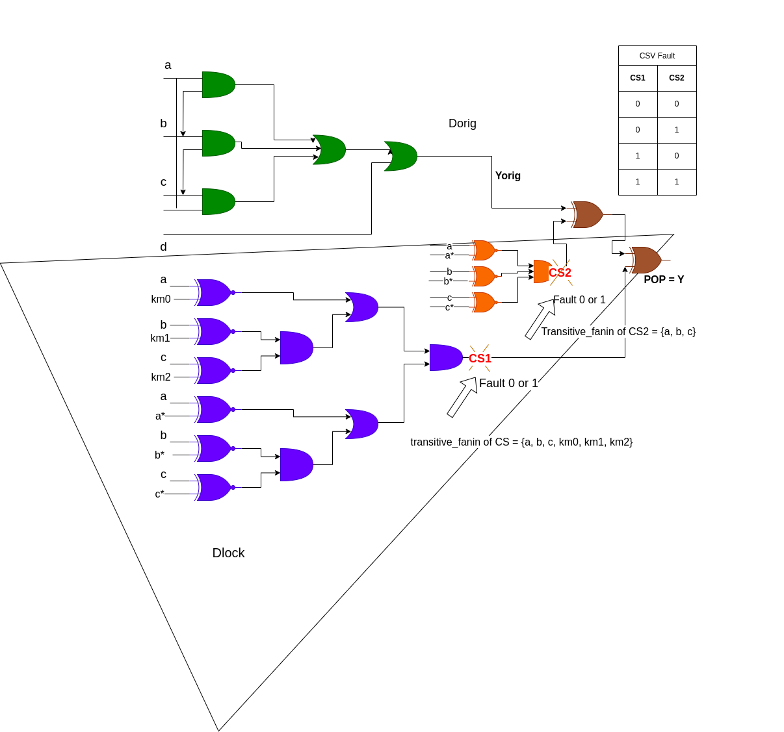
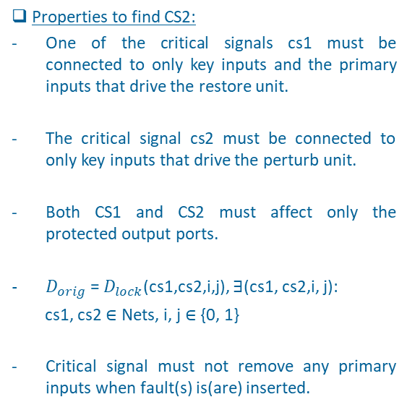
Statement | Implemented method. | Acquire PI, KI & POP | Find CS | SFLT CSV | DFLT CSV | CR attack | Test results & demo | Deliverable | Summary |
Critical signal values on DFLT designs:
Properties to find CS2:
One of the critical signals cs1 must be connected to only key inputs and the primary inputs that drive the restore unit.
The critical signal cs2 must be connected to only key inputs that drive the perturb unit.
Both CS1 and CS2 must affect only the protected output ports.
$D_{orig}$ = $D_{lock}$(cs1,cs2,i,j), ∃(cs1, cs2,i, j):
cs1, cs2 ∈ Nets, i, j ∈ {0, 1}
Critical signal must not remove any primary inputs when fault(s) is(are) inserted.
Fig. 5: Inserting fault at CS1 & CS2 to restore original circuit

Slide 11
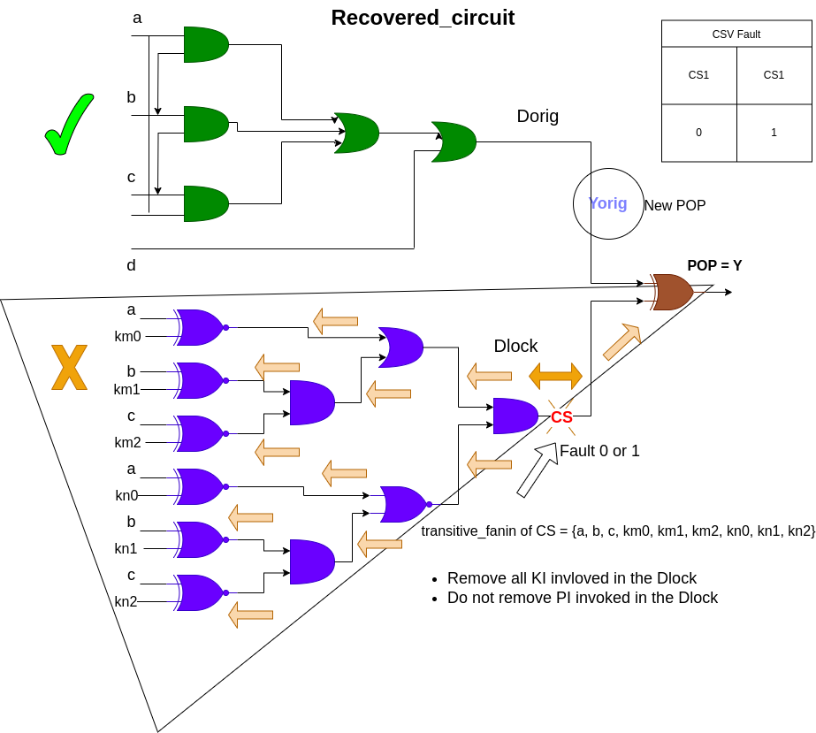
Statement | Implemented method. | Acquire PI, KI & POP | Find CS | SFLT CSV | DFLT CSV | CR attack | Test results & demo | Deliverable | Summary |
CR Attack:
Fig. 6: Recovered circuit

Slide 12

Statement | Implemented method. | Acquire PI, KI & POP | Find CS | SFLT CSV | DFLT CSV | CR attack | Test results & demo | Deliverable | Summary |
CR Attack:
Fig. 7: Inverted recovered circuit

Slide 13
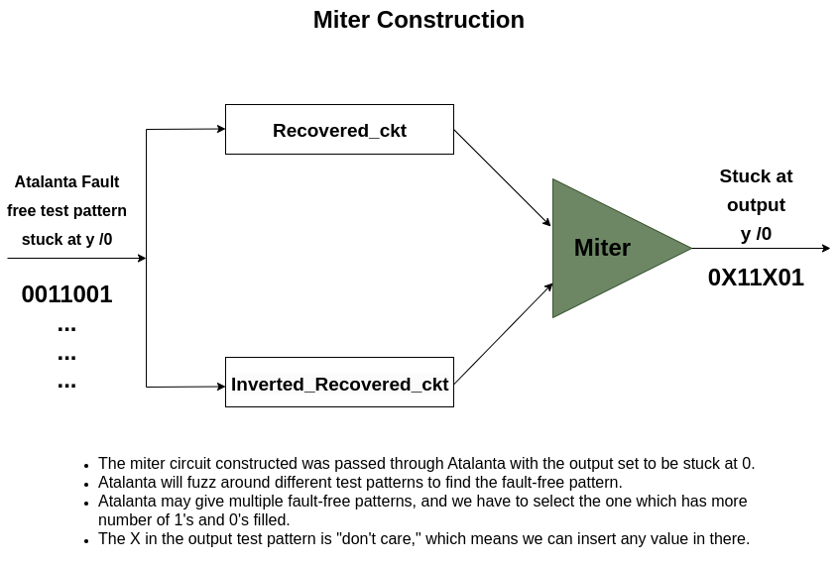
Statement | Implemented method. | Acquire PI, KI & POP | Find CS | SFLT CSV | DFLT CSV | CR attack | Test results & demo | Deliverable | Summary |
CR Attack:
Fig. 8: Miter construction

Slide 14
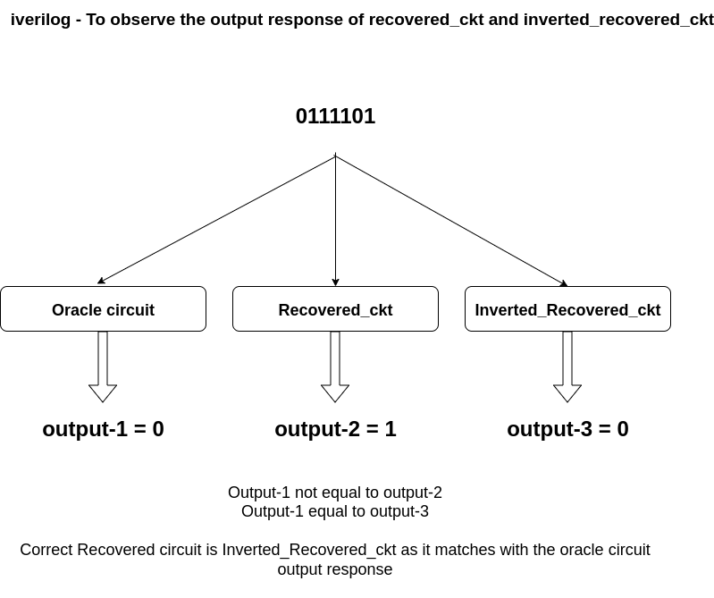
Statement | Implemented method. | Acquire PI, KI & POP | Find CS | SFLT CSV | DFLT CSV | CR attack | Test results & demo | Deliverable | Summary |
CR Attack:
Fig. 9: Circuit verification process

Slide 15
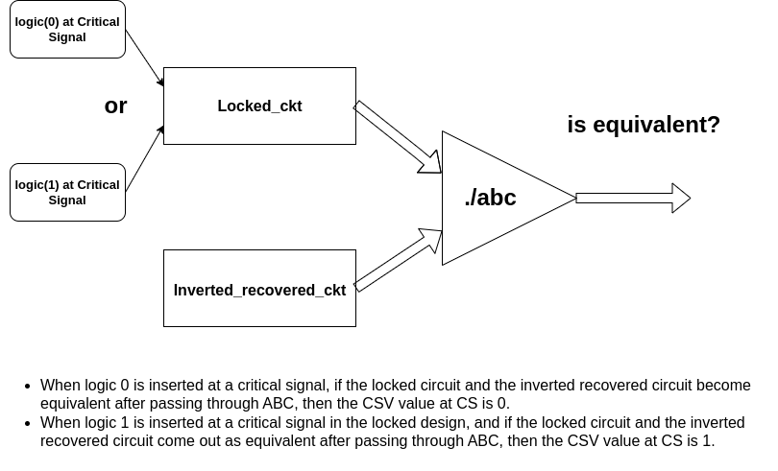
Statement | Implemented method. | Acquire PI, KI & POP | Find CS | SFLT CSV | DFLT CSV | CR attack | Test results & demo | Deliverable | Summary |
CR Attack:
Fig. 10: Finding critical signal value with the help of abc tool to check for equivalence

Slide 16
Statement | Implemented method. | Acquire PI, KI & POP | Find CS | SFLT CSV | DFLT CSV | CR attack | Test results & demo | Deliverable | Summary |
Test results:
Trials: 240/240 Success rate: 100% b14_C: 8 min, 30 sec
b15_C: 4 min, 26 sec
b17_C: 3 h, 37 min, 9 sec
b20_C: 33 min, 45 sec
b21_C: 35 min, 17 sec
b22_C: 1 h, 7 min, 36 sec
Total execution time: 6 hours, 16 min
Trials: 240/240 Success rate: 100% b14_C: 10 min, 3 sec
b15_C: 31 min, 3 sec
b17_C: 3 h, 41 min, 0 sec
b20_C: 38 min, 5 sec
b21_C: 36 min, 20 sec
b22_C: 1 h, 12 min, 53 sec
Total execution time: 6 hours, 47 min
Trials: 240/240 Success rate: 100% b14_C: 8 min, 28 sec
b15_C: 26 min, 6 sec
b17_C: 3 h, 39 min, 45 sec
b20_C: 34 min, 29 sec
b21_C: 35 min, 27 sec
b22_C: 1h, 11 min, 20 sec
Total execution time: 7 h, 18 min

Slide 17
Statement | Implemented method. | Acquire PI, KI & POP | Find CS | SFLT CSV | DFLT CSV | CR attack | Test results & demo | Deliverable | Summary |
Test results:
Trials: 357/360 Success rate: 99.16% b14_C: 2 min, 31 sec
b15_C: 6 min, 28 sec
b17_C: 16 min, 54 sec
b20_C: 5 min, 17 sec
b21_C: 6 min, 05 sec
b22_C: 8 min, 18 sec
Total execution time: 45 min, 33 sec
Trials: 238/240 Success rate: 99.16% b14_C: 1 min, 28 sec
b15_C: 3 min, 37 sec
b17_C: 20 min, 29 sec
b20_C: 2 min, 47 sec
b21_C: 3 min, 24 sec
b22_C: 8 min, 11 sec
Total execution time: 39 min, 56 sec

Slide 18
Statement | Implemented method. | Acquire PI, KI & POP | Find CS | SFLT CSV | DFLT CSV | CR attack | Test results & demo | Deliverable | Summary |
Test results:
Trials: 357/360 Success rate: 99.16% b14_C: 4 h, 0 min, 9 sec
b15_C: 13 min, 29 sec
b17_C: 1 h, 54 min, 50 sec
b20_C: 17 min, 34 sec
b21_C: 17 min, 13 sec
b22_C: 36 min, 46 sec
Total execution time: 7 h, 20 min
Trials: 238/240 Success rate: 99.16% b14_C: 4 min, 24 sec
b15_C: 12 min, 57 sec
b17_C: 2 h, 5 min, 7 sec
b20_C: 20 min, 57 sec
b21_C: 20 min, 57 sec
b22_C: 35 min, 46 sec
Total execution time: 3 h, 56 min

Slide 19
Statement | Implemented method. | Acquire PI, KI & POP | Find CS | SFLT CSV | DFLT CSV | CR attack | Test results & demo | Deliverable | Summary |
Test results:
Trials: 357/360 Success rate: 99.16% b14_C: 4 min, 17 sec
b15_C: 13 min, 49 sec
b17_C: 1 h, 56 min, 58 sec
b20_C: 17 min, 55 sec
b21_C: 17 min, 31 sec
b22_C: 36 min, 49 sec
Total execution time: 3 h, 23 min
Trials: 238/240 Success rate: 99.16% b14_C: 4 min, 14 sec
b15_C: 12 min, 59 sec
b17_C: 1 h, 54 min, 29 sec
b20_C: 17 min, 45 sec
b21_C: 17 min, 43 sec
b22_C: 38 min, 26 sec
Total execution time: 3 h, 22 min

Slide 20
Statement | Implemented method. | Acquire PI, KI & POP | Find CS | SFLT CSV | DFLT CSV | CR attack | Test results & demo | Deliverable | Summary |
Test results:
Trials: 240/240 Success rate: 100% b14_C: 1 min, 03 sec
b15_C: 1 min, 47 sec
b17_C: 6 min, 31 sec
b20_C: 2 min, 27 sec
b21_C: 2 min, 28 sec
b22_C: 4 min, 33 sec
Total execution time: 18 min, 49 sec
Trials: 240/240 Success rate: 100% b14_C: 1 min, 07 sec
b15_C: 1 min, 47 sec
b17_C: 6 min, 35 sec
b20_C: 2 min, 27 sec
b21_C: 2 min, 23 sec
b22_C: 4 min, 16 sec
Total execution time: 18 min, 35 sec

Slide 21
Statement | Implemented method. | Acquire PI, KI & POP | Find CS | SFLT CSV | DFLT CSV | CR attack | Test results & demo | Deliverable | Summary |
Test results:
Trials: 237/240 Success rate: 98.75% b14_C: 30 min, 41 sec
b15_C: 1 h, 43 min, 18 sec
b17_C: 18 h, 7 min, 25 sec
b20_C: 2 h, 52 min, 24 sec
b21_C: 2 h, 48 min, 13 sec
b22_C: 7 h, 12 min, 50 sec
Total execution time: 33 h, 53 min, 51 sec
Trials: 239/240 Success rate: 100% b14_C: 0 min, 50 sec
b15_C: 1 min, 25 sec
b17_C: 5 min, 24 sec
b20_C: 1 min, 58 sec
b21_C: 2 min, 23 sec
b22_C: 3 min, 12 sec
Total execution time: 18 min, 35 sec

Slide 22
Statement | Implemented method. | Acquire PI, KI & POP | Find CS | SFLT CSV | DFLT CSV | CR attack | Test results & demo | Deliverable | Summary |
Test results:
Trials: 120/120 Success rate: 100% b14_C: 0 min, 43 sec
b15_C: 2 min, 43 sec
b17_C: 6 min, 06 sec
b20_C: 1 min, 39 sec
b21_C: 1 min, 51 sec
b22_C: 2 min, 52 sec
Total execution time: 15 min, 54 sec
Trials: 119/120 Success rate: 99.16% b14_C: 0 min, 41 sec
b15_C: 2 min, 41 sec
b17_C: 6 min, 07 sec
b20_C: 1 min, 38 sec
b21_C: 1 min, 48 sec
b22_C: 2 min, 38 sec
Total execution time: 15 min, 33 sec

Slide 23
Statement | Implemented method. | Acquire PI, KI & POP | Find CS | SFLT CSV | DFLT CSV | CR attack | Test results & demo | Deliverable | Summary |
Test results:
Trials: 120/120 Success rate: 100% b14_C: 0 min, 43 sec
b15_C: 2 min, 33 sec
b17_C: 5 min, 09 sec
b20_C: 2 min, 01 sec
b21_C: 1 min, 58 sec
b22_C: 2 min, 34 sec
Total execution time: 14 min, 58 sec
Trials: 120/120 Success rate: 100% b14_C: 0 min, 42 sec
b15_C: 2 min, 23 sec
b17_C: 5 min, 11 sec
b20_C: 2 min, 02 sec
b21_C: 1 min, 49 sec
b22_C: 2 min, 34 sec
Total execution time: 14 min, 41 sec

Slide 24
Statement | Implemented method. | Acquire PI, KI & POP | Find CS | SFLT CSV | DFLT CSV | CR attack | Test results & demo | Deliverable | Summary |
Test results:
Trials: 119/120 Success rate: 100% b14_C: 2 min, 20 sec
b15_C: 7 min, 56 sec
b17_C: 1 h, 25 min, 53 sec
b20_C: 10 min, 09 sec
b21_C: 11 min, 59 sec
b22_C: 11 min, 59 sec
Total execution time: 2 h, 10 min
Trials: 120/120 Success rate: 100% b14_C: 2 min, 12 sec
b15_C: 6 min, 44 sec
b17_C: 1 h, 11 min, 27 sec
b20_C: 9 min, 32 sec
b21_C: 10 min, 47 sec
b22_C: 20 min, 09 sec
Total execution time: 2 h, 00 min

Slide 25
Statement | Implemented method. | Acquire PI, KI & POP | Find CS | SFLT CSV | DFLT CSV | CR attack | Test results & demo | Deliverable | Summary |
Test results:
Trials: 20/20 Success rate: 100% b14_C: 4 min, 1 sec
b15_C: pending
b17_C: pending
b20_C: pending
b21_C: pending
b22_C: pending
Total execution time: 4 min, 1 sec
Trials: 20/20 Success rate: 100% b14_C: 4 min, 06 sec
b15_C: pending
b17_C: pending
b20_C: pending
b21_C: pending
b22_C: pending
Total execution time: 4 min, 06 sec

Slide 26
Statement | Implemented method. | Acquire PI, KI & POP | Find CS | SFLT CSV | DFLT CSV | CR attack | Test results & demo | Deliverable | Summary |
Test results:
Trials: 20/20 Success rate: 100% b14_C: 4 min, 1 sec
b15_C: pending
b17_C: pending
b20_C: pending
b21_C: pending
b22_C: pending
Total execution time: 4 min, 1 sec
Trials: 20/20 Success rate: 100% b14_C: 4 min, 06 sec
b15_C: pending
b17_C: pending
b20_C: pending
b21_C: pending
b22_C: pending
Total execution time: 4 min, 06 sec

Slide 27
Statement | Implemented method. | Acquire PI, KI & POP | Find CS | SFLT CSV | DFLT CSV | CR attack | Test results & demo | Deliverable | Summary |
Test results:
Trials: 20/120 Success rate: 100% b14_C: 9 min, 16 sec
b15_C: 28 min, 28 sec
b17_C: 31 min, 14 sec
b20_C: 46 min, 30 sec
b21_C: 45 min, 45 sec
b22_C: 1 h, 43 min, 51 sec
Total execution time: 4 h, 22 min
Trials: 20/120 Success rate: 100% b14_C: 10 min, 07 sec
b15_C: 30 min, 55 sec
b17_C: 9 h, 2 min, 33 sec
b20_C: 44 min, 6 sec
b21_C: 44 min, 18 sec
b22_C: 1 h, 39 min, 07 sec
Total execution time: 12 h, 39 min

Slide 28
Statement | Implemented method. | Acquire PI, KI & POP | Find CS | SFLT CSV | DFLT CSV | CR attack | Test results & demo | Deliverable | Summary |
Test results:
Trials: 40/40 Success rate: 100% b14_C: 9 min, 16 sec
b15_C: pending
b17_C: pending
b20_C: pending
b21_C: pending
b22_C: pending
Total execution time: 4 h, 22 min
Trials: 40/40 Success rate: 100% b14_C: 1 h, 38 min, 30 sec
b15_C: pending
b17_C: pending
b20_C: pending
b21_C: pending
b22_C: pending
Total execution time: 12 h, 39 min

Slide 29
Statement | Implemented method. | Acquire PI, KI & POP | Find CS | SFLT CSV | DFLT CSV | CR attack | Test results & demo | Deliverable | Summary |
Test results:
Trials: 240/240 Success rate: 100% b14_C: SFLT: 10 min, 36 sec, DFLT: 10 min, 35 sec
b15_C: SFLT: 33 min, 17 sec, DFLT: 1 h, 10 min, 48 sec
b17_C: SFLT: 4 h, 14 min, 21 sec, DFLT: 18 h, 42 min, 44 sec
b20_C: SFLT: 40 min, 23 sec, DFLT: 1 h, 23 min, 53 sec
b21_C: SFLT: 41 min, 05 sec, DFLT: 1 h, 26 min, 48 sec
b22_C: SFLT: 1 h, 17 min, 29 sec, DFLT: 3 h, 29 min, 36 sec
Total execution time: 7 h, 59 min + 24 h, 20 min = 32h, 19m
Trials: 240/240 Success rate: 100% b14_C: SFLT: 8 min, 7 sec, DFLT: 7 min, 58 sec
b15_C: SFLT: 55 min, 13 sec, DFLT: 57 min, 34 sec
b17_C: SFLT: 18 h, 43 min, 13 sec, DFLT: 16 h, 50 min, 50 sec
b20_C: SFLT: 1 h, 15 min, 57 sec, DFLT: 1 h, 14 min, 52 sec
b21_C: SFLT: 1 h, 47 min, 53 sec, DFLT: 1 h, 23 min, 23 sec
b22_C: SFLT: 3 h, 54 min, 08 sec, DFLT: 2 h, 52 min, 36 sec
Total execution time: 23 h, 42 min + 20 h, 23 min = 44 h, 5 m

Slide 30
Statement | Implemented method. | Acquire PI, KI & POP | Find CS | SFLT CSV | DFLT CSV | CR attack | Test results & demo | Deliverable | Summary |
Test results:
Trials: 240/240 Success rate: 100% b14_C: SFLT: 11 min, 07 sec, DFLT: 8 min, 43 sec
b15_C: SFLT: 16 min, 29 sec, DFLT: 15 min, 20 sec
b17_C: SFLT: 2 h, 21 min, 36 sec, DFLT: 1 h, 55 min, 12 sec
b20_C: SFLT: 21 min, 50 sec, DFLT: 18 min, 59 sec
b21_C: SFLT: 31 min, 15 sec, DFLT: 30 min, 17 sec
b22_C: SFLT: 45 min, 00 sec, DFLT: 37 min, 30 sec
Total execution time: 4 h, 35 min + 3 h, 43 min = 8h, 18m
Trials: 240/240 Success rate: 100% b14_C: SFLT: 5 min, 14 sec, DFLT: 4 min, 57 sec
b15_C: SFLT: 12 min, 59 sec, DFLT: 16 min, 21 sec
b17_C: SFLT: 2 h, 31 min, 00 sec, DFLT: 2 h, 01 min, 06 sec
b20_C: SFLT: 17 min, 47 sec, DFLT: 17 min, 38 sec
b21_C: SFLT: 18 min, 22 sec, DFLT: 19 min, 24 sec
b22_C: SFLT: 34 min, 48 sec, DFLT: 35 min, 30 sec
Total execution time: 4 h, 57 min + 4 h, 32 min = 9 h, 29 m

Slide 31
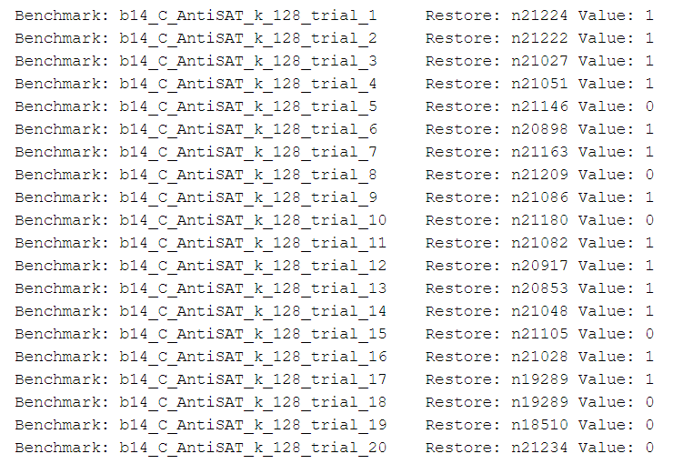
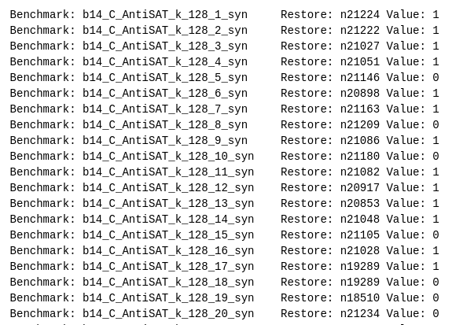
Statement | Implemented method. | Acquire PI, KI & POP | Find CS | SFLT CSV | DFLT CSV | CR attack | Test results & demo | Deliverable | Summary |
Test results:
Valkyrie – AntiSAT-Aggr-b14 csv result
CR-Attack – AntiSAT-Aggr-b14 csv result
Fig. 11: Comparison check of results obtained from Valkyrie and CR_attack

Slide 32
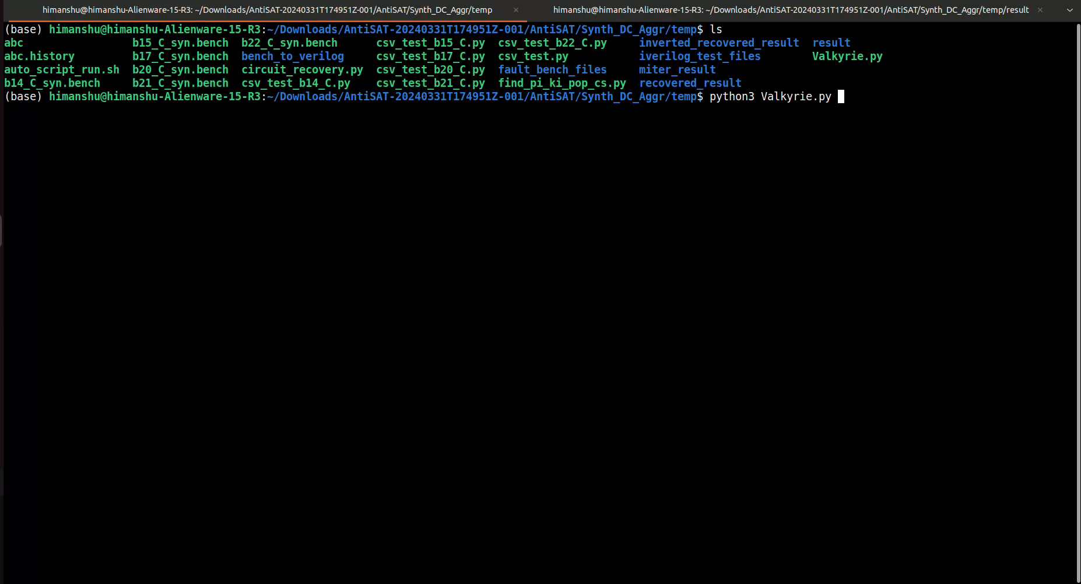
Statement | Implemented method. | Acquire PI, KI & POP | Find CS | SFLT CSV | DFLT CSV | CR attack | Test results & demo | Deliverable | Summary |
Demo Recording: Valkyrie

Slide 33
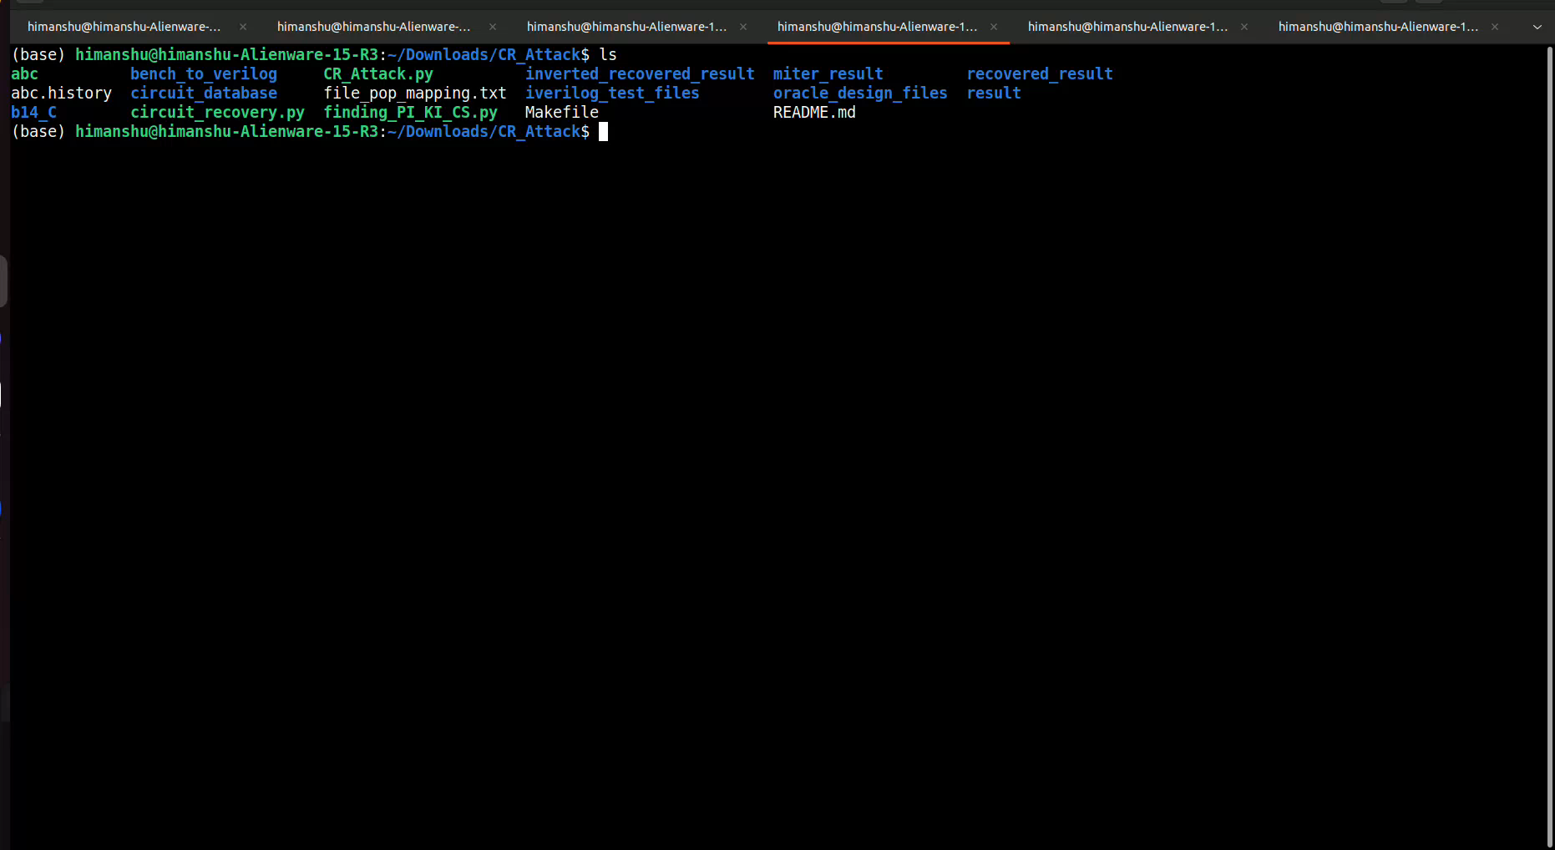
Statement | Implemented method. | Acquire PI, KI & POP | Find CS | SFLT CSV | DFLT CSV | CR attack | Test results & demo | Deliverable | Summary |
Demo Recording: CR Attack

Slide 34
Statement | Implemented method. | Acquire PI, KI & POP | Find CS | SFLT CSV | DFLT CSV | CR attack | Test results & demo | Deliverable | Summary |
Deliverables achieved and not achieved
Deliverable: 90%
Able to find PI, KI, POP, and critical signal
Able to perform Valkyrie for SFLT and DFLT designs
Able to achieve circuit recovery attack on SFLT designs
Deliverable not achieved: 10%
Unable to perform circuit recovery for DFLT designs.
Unable to perform testing on SARLock basic and Genus designs due to time limitation.
Fig. 12: Percentage of Valkyrie successful and failed test trials

Slide 35
Statement | Implemented method. | Acquire PI, KI & POP | Find CS | SFLT CSV | DFLT CSV | CR attack | Test results & demo | Deliverable | Summary |
Summary:
Different PSLL techniques leave structural traces in the design which can be used by the attacker to recover the original circuit design.
Using the vulnerability assessment tool (Valkyrie), the defenders can analyze vulnerable wires (Critical signals) and - add mitigations to protect their circuit logic design from IP piracy and IC overproduction.
Using the CR attack tool, the attacker can find the vulnerable wires and the found values which can lead to the restoration of the original circuit without the need for an oracle (functional circuit).

